Slide 1


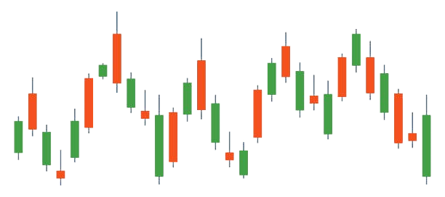
Capstone Project Phase A
Stock Trend Prediction Using Sentiment Analysis
Project code: 25-2-R-6
Shelly Trifonov
Guy Naeh
Supervisor: Mr. Ilya Zeldner
1

Slide 2

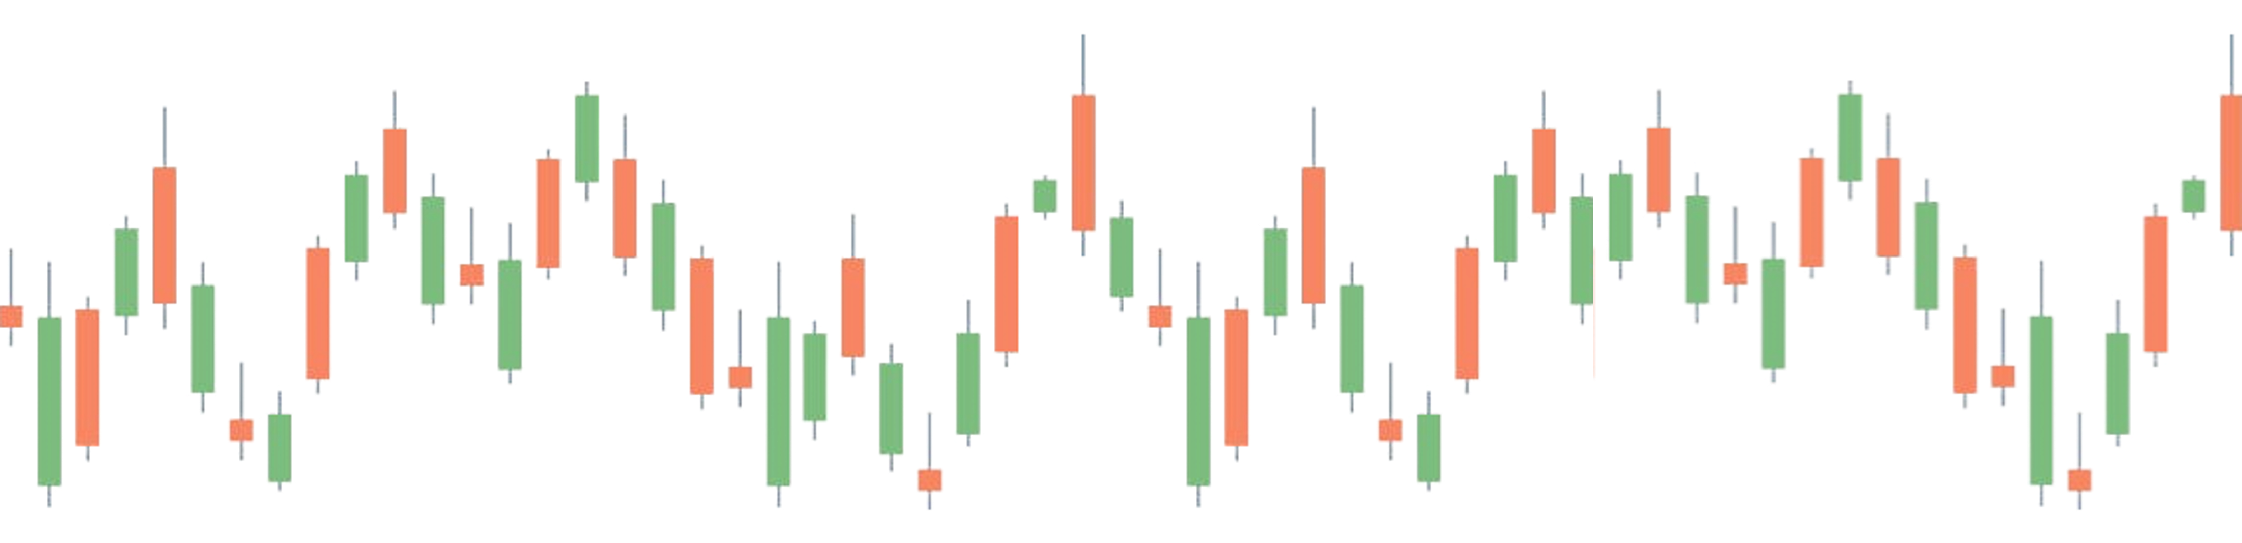
The Problem
Most traditional stock prediction models rely mostly on historical stock data
Stock market is highly affected by public opinion and events
News & social media shift trends rapidly
2
Notes:
Let’s begin with the problem.
Most traditional stock prediction models rely mostly—or even entirely—on historical stock data.
But in today's market, that's not enough.
The biggest price movements are often triggered by public sentiment, news events, or social media reactions.
For example, imagine if tomorrow morning, Donald Trump publicly criticizes Tesla.
The stock might drop significantly by the end of the day—not because of anything in its historical trend, but because of a sudden shift in public opinion.
These emotional, fast-changing factors are critical to market behavior.
Ignoring them can lead to less accurate predictions.

Slide 3

Previous Research Findings
Using both stock prices and sentiment scores improves prediction the most
LSTM (Long Short-Term Memory) outperforms other models in accuracy
3
Notes:
Although there are only a few studies that integrate sentiment analysis into stock prediction, their results are consistently impressive.
They show that when we add sentiment data—from news or social media—the prediction becomes significantly more accurate.
Also, LSTM models consistently deliver the highest accuracy in recent studies.
So the conclusion is clear: combining numerical stock data with sentiment signals, and using advanced models like LSTM, gives the best results.

Slide 4
Our Project
TrendiQ will predict short-term stock movements
It will combine historical prices with sentiment from news & Twitter
An LSTM model will be used to predict daily Up/Down movement
4
Notes:
Our solution is a smart forecasting system.
It predicts short-term stock movements using historical prices and public sentiment.
Sentiment is extracted from financial news and Twitter.
We use an LSTM model to predict whether the stock will go up or down the next day.

Slide 5

Our advantages
Multi-source inputs
Short-term focus
User-friendly UI
5
Notes:
Here are the key advantages of our system:
First, we use multiple data sources — not just stock prices, but also sentiment from news and social media.
This gives us a more complete view of market conditions.
Second, we focus on near-future predictions, which help active traders make quick decisions.
And finally, we designed a simple and intuitive user interface, so users can easily access predictions without needing a technical background.

Slide 6
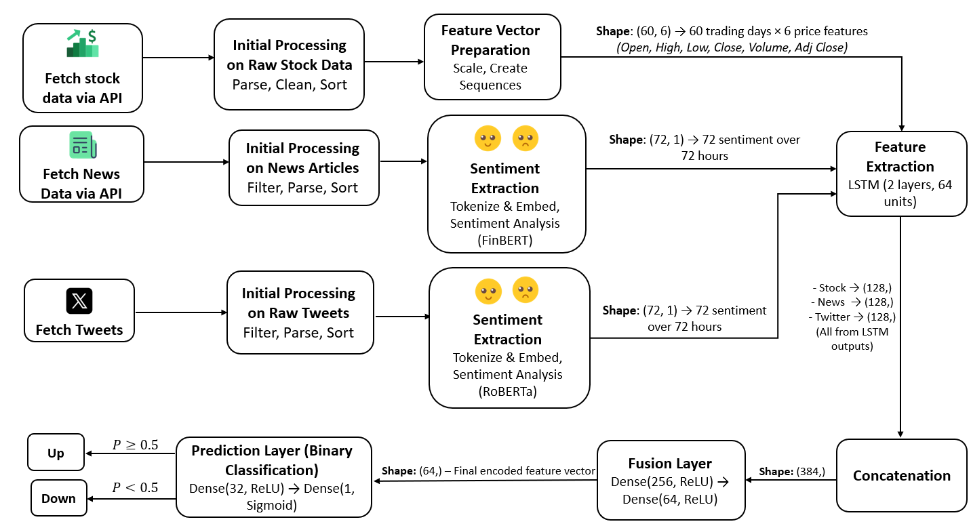
System Architecture
6
Notes:
This is the full system architecture.
In the next slides, I’ll go over each part separately.

Slide 7
Data Collection
Stock data: last 60 trading days
News & tweets: last 72 hours
Cleaned, filtered and aligned chronologically
Aggregated and padded if needed
7
Notes:
We collect stock and news data using APIs, and tweets are scraped directly from X.
Each source is handled separately, cleaned, and then synchronized by time.
We use 60 days of stock data because it takes time to detect price patterns and trends.
But sentiment — like tweets or news — only impacts the market in the short term.
A negative post today might cause the stock to drop tomorrow, but by the next week, it's usually forgotten. So 3 days of sentiment is enough.

Slide 8
Feature Extraction
Stock -> Price sequences -> LSTM
News data -> Sentiment scoring -> LSTM
Tweets -> Sentiment scoring -> LSTM
LSTM Output: 3 feature vectors (128 dimensions each)
8
Notes:
At this stage, we extract features from three different data sources: stock prices, news articles, and tweets.
We take the past 60 days of stock prices and turn them into sequences. That way, the model can learn how the stock moves over time.
For News and Tweets:
Because news and tweets are just plain text, we need to analyze the words and figure out the general feeling — if it's positive, negative, or neutral — before we can use it in the model.
Sentiment scoring is a way to give a number to how positive, negative, or neutral the news or tweets were on a certain day — and how strong that feeling was.
It turns opinions and emotions into a score we can use in the model.
Each input — stock prices, news sentiment, and tweet sentiment — goes into its own separate LSTM network.
They all use the same structure, but they are trained separately. So each one produces its own output vector.

Slide 9
Fusion, Prediction & Training
Combine 3 vectors -> 384-d input
Dense layers: 256 -> 64 -> 32
Final layer: Sigmoid -> returns probability (Up/Down)
Output: Direction + confidence level
Training:
Loss: Binary Cross-Entropy
Optimizer: Adam (lr=0.001)
Dropout: 0.2 | Epochs: 50 | Early Stopping
9
Notes:
In this stage, we take the three feature vectors — one from stock data, one from news, and one from tweets — and combine them into a single input.
Then we pass it through a few dense layers to learn deeper patterns.
The final Dense layer uses a sigmoid activation, which turns the output into a probability between 0 and 1 — representing how confident the model is that the stock will go up.
We train the whole pipeline together — not just the final layers. That means the model also learns how to better extract useful information from prices and sentiment while training.

Slide 10

Excepted Outcomes
Higher accuracy
Sentiment boosts performance
Short-term forecasting window
Functional tool
10

Slide 11
Model Evaluation & Validation
Confusion Matrix
Compares model predictions with real outcomes.
Recall
How many actual positives the model managed to catch.
Accuracy
Percentage of total predictions that were correct.
F1 Score
Balance between precision and recall.
Precision
How many predicted positives were actually correct.
ROC-AUC
How well the model separates between classes (up vs. down).
11

Slide 12

Excepted Challenges
Temporal misalignment
Noisy text
Overfitting risk
Generalization issues
Limited labeled data
12

Slide 13

Verification & Testing Strategy
Full pipeline run
Missing data handling
Contradictory sentiment
Outliers
Non-English tweets
13

Slide 14
Development Stack & Technologies
Python 3.10
Pytorch
HiggingFace Transformers
yfinance
SpaCy / NLTK
Apache Spark
14

Slide 15

Use Case Diagram
User Interaction With Prediction Dashboard
User
Export Prediction Reports
<<Extend>>
View Stock Prediction Details
View System Status and Data Updates
View Dashboard
<<Extend>>
Filter and Sort Stocks
<<Include>>
<<Include>>
<<Extend>>
Search for Stock
View Forecast Charts and Tables
Receive Significant Forecast Alerts
System
15

Slide 16
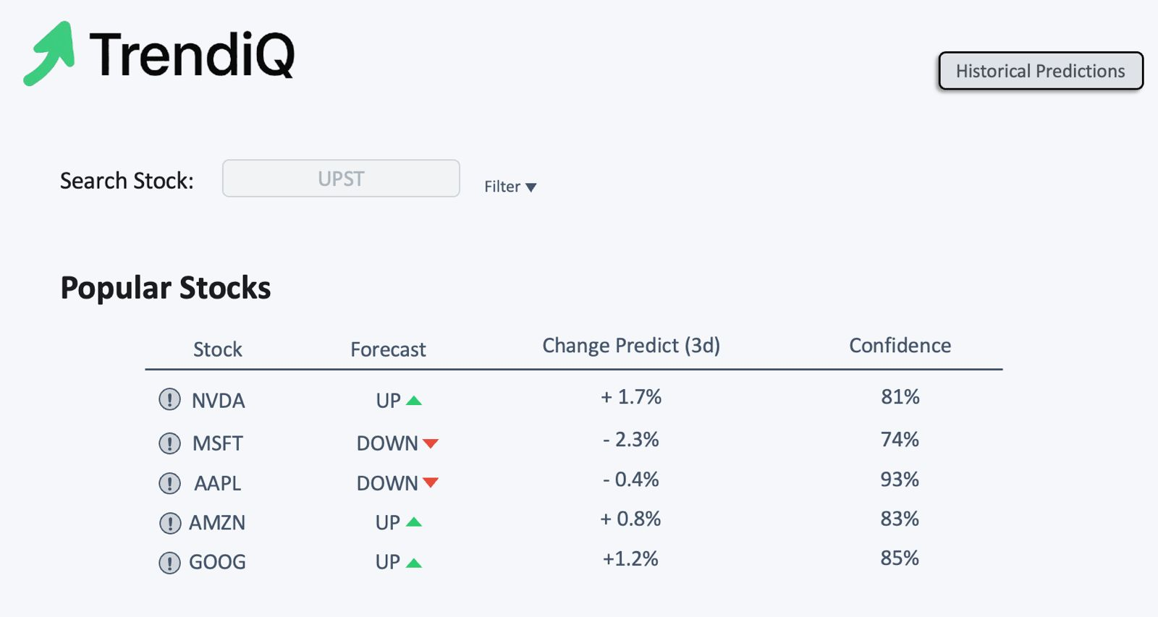
User Interface
16

Slide 17
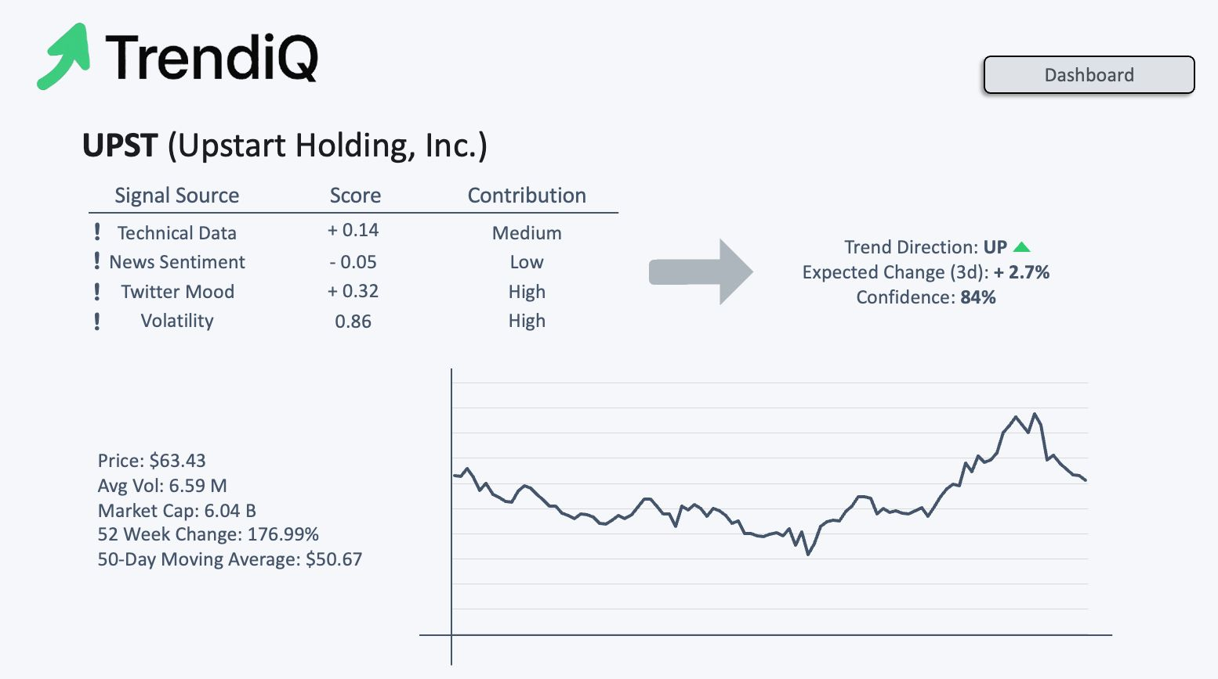
User Interface
17

Slide 18
Thank You !
18

